Slide 1



Rice Leaf Diseases Detection
Project Id:- PRCP-1001-RiceLeaf
Project Team Id:- 1107
Team Members:-
Ayush Mehta
Ali Hasan

Slide 2
INTRODUCTION
In developing countries, farming land can be much larger and farmers cannot observe each and every plant, every day. Farmers are unaware of non-native diseases.
The model will help them in detecting which of the diseases the rice leaf has.
To perform Rice diseases prediction, some basic knowledge on neural network, CNN and image processing is needed.

Slide 3
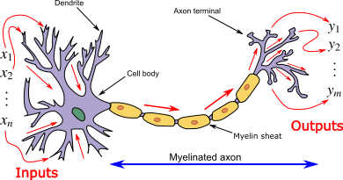
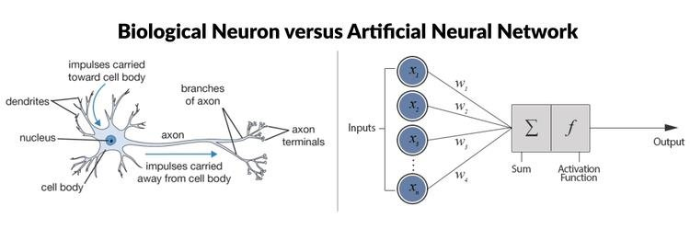
Artificial Neural Network (ANN)
An artificial neural network (ANN) is the piece of a computing system designed to simulate the way the human brain analyses and processes information.
An ANN is based on a collection of connected units or nodes called artificial neuron, which loosely model the neurons in a biological brain.

Slide 4
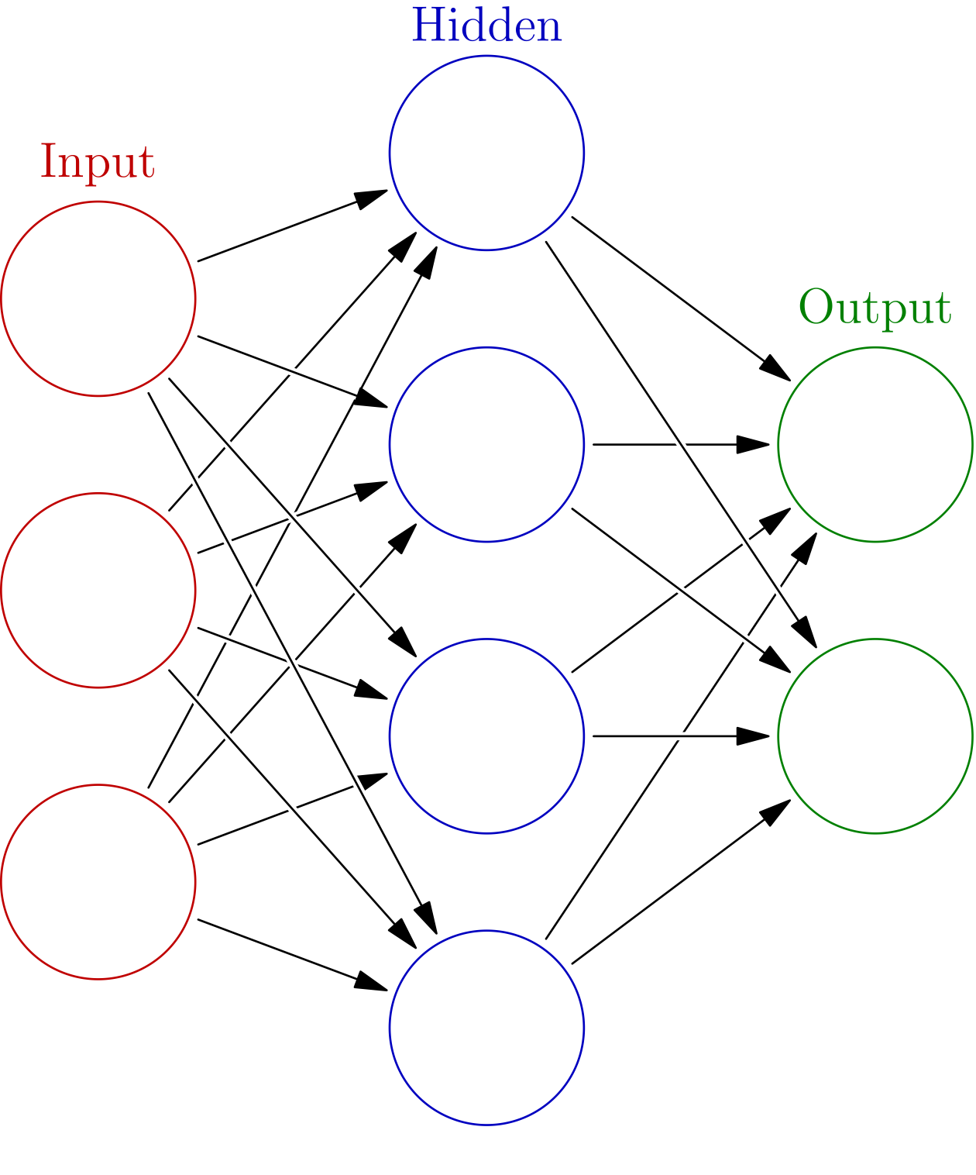
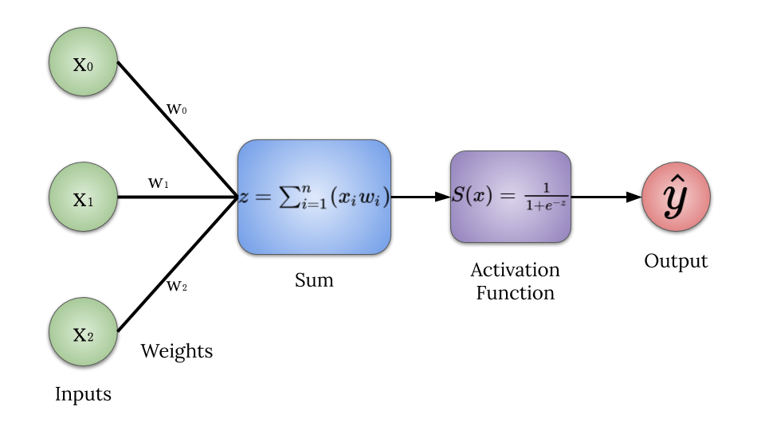
Components of ANN
Neurons :- Each artificial neuron has inputs and produces a single output which can be sent to multiple other neurons. The inputs can be the feature values of a sample of external data, such as images or documents, or they can be the outputs of other neurons. The outputs of the final output neurons of the neural net accomplish the task, such as recognizing an object in an image.
Connections and weights :- The network consists of connections, each connection providing the output of one neuron as an input to another neuron. Each connection is assigned a weight that represents its relative importance. A given neuron can have multiple input and output connections.
Propagation function:- The propagation function computes the input to a neuron from the outputs of its predecessor neurons and their connections as a weighted sum. A bias term can be added to the result of the propagation.

Slide 5

Convolution Neural Network (CNN)
In deep learning, a convolutional neural network (CNN, or ConvNet) is a class of deep neural network, most commonly applied to analysing visual imagery.

Slide 6
Convolution Layers
There are three types of layers that make up the CNN which are the convolutional layers, pooling layers, and fully-connected (FC) layers. When these layers are stacked, a CNN architecture will be formed. In addition to these three layers, there are two more important parameters which are the dropout layer and the activation function.
Layers of CNN:-
1.Convolution layers
2.Pooling layers
3.Fully-connected layers

Slide 7
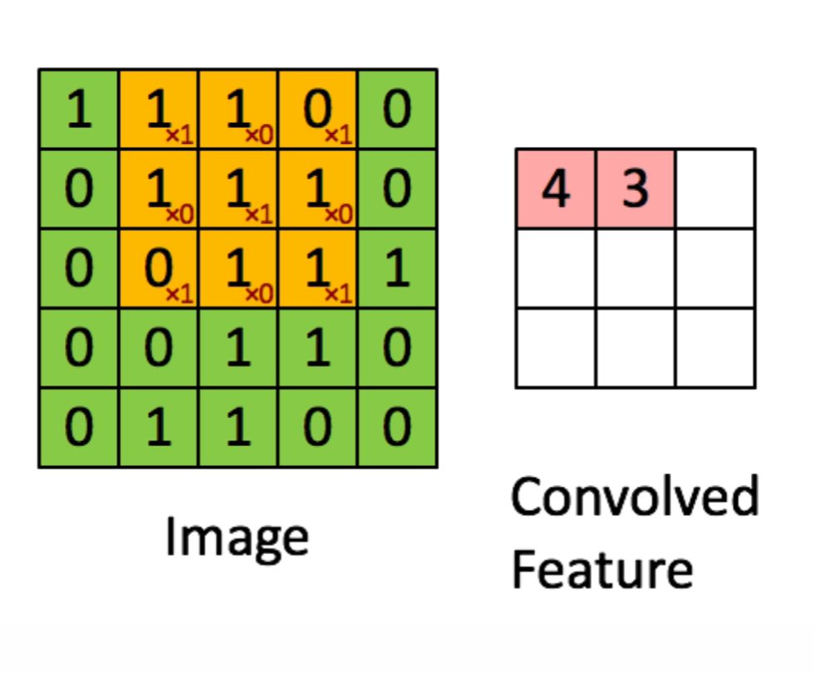
1.Convolution layers
This layer is the first layer that is used to extract the various features from the input images. In this layer, the mathematical operation of convolution is performed between the input image and a filter of a particular size MxM. By sliding the filter over the input image, the dot product is taken between the filter and the parts of the input image with respect to the size of the filter (MxM).
The output is termed as the Feature map which gives us information about the image such as the corners and edges. Later, this feature map is fed to other layers to learn several other features of the input image.
Image Dimensions = 5 (Height) x 5 (Breadth) x 1 (Number of channels, example: RGB)
In the above demonstration, the green section resembles our 5x5x1 input image, I. The element involved in carrying out the convolution operation in the first part of a Convolutional Layer is called the Kernel/Filter, K, represented in the colour yellow. We have selected K as a 3x3x1 matrix.

Slide 8
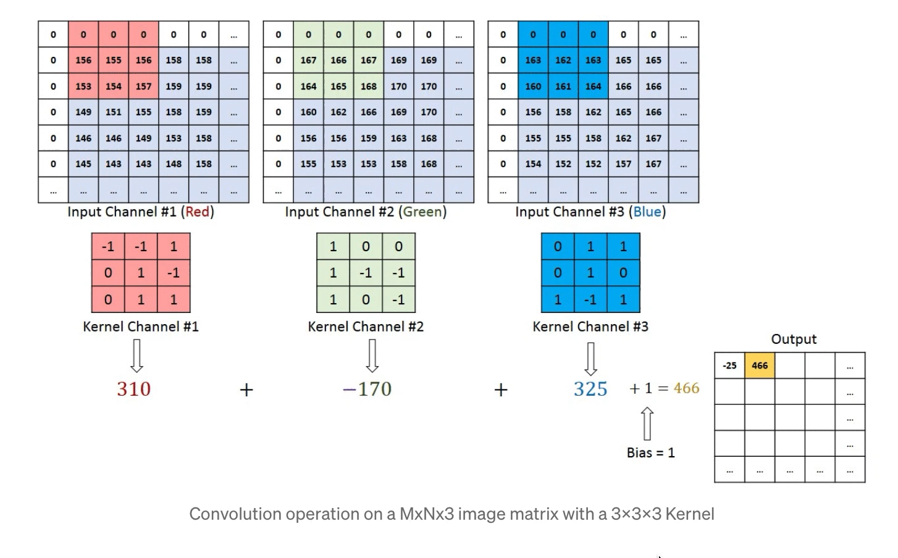
In the case of images with multiple channels (e.g. RGB), the Kernel has the same depth as that of the input image. Matrix Multiplication is performed between Kn and In stack ([K1, I1]; [K2, I2]; [K3, I3]) and all the results are summed with the bias to give us a squashed one-depth channel Convoluted Feature Output.

Slide 9
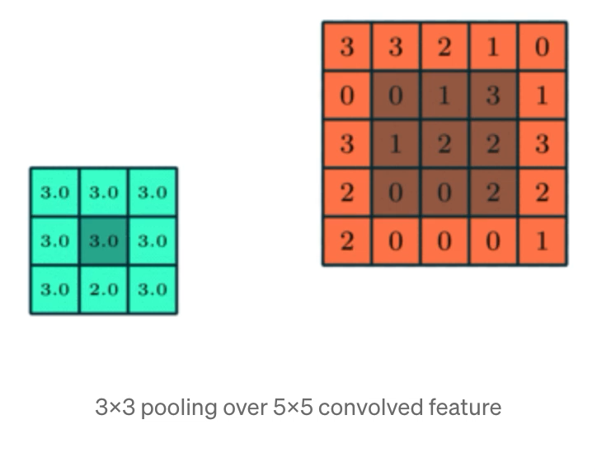

2.Pooling layers
In most cases, a Convolutional Layer is followed by a Pooling Layer. The primary aim of this layer is to decrease the size of the convolved feature map to reduce the computational costs. This is performed by decreasing the connections between layers and independently operates on each feature map. Depending upon method used, there are several types of Pooling operations.
In Max Pooling, the largest element is taken from feature map. Average Pooling calculates the average of the elements in a predefined sized Image section.

Slide 10
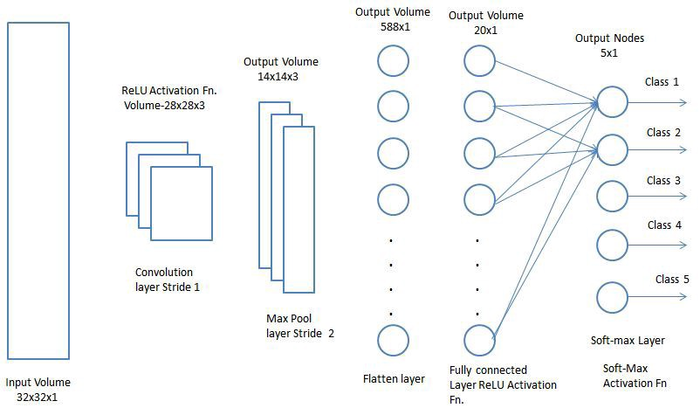
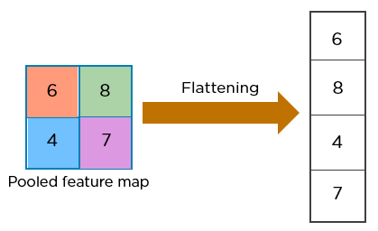
3.Fully-connected layers
The Fully Connected (FC) layer consists of the weights and biases along with the neurons and is used to connect the neurons between two different layers. These layers are usually placed before the output layer and form the last few layers of a CNN Architecture.
In this, the input image from the previous layers are flattened and fed to the FC layer.

Slide 11
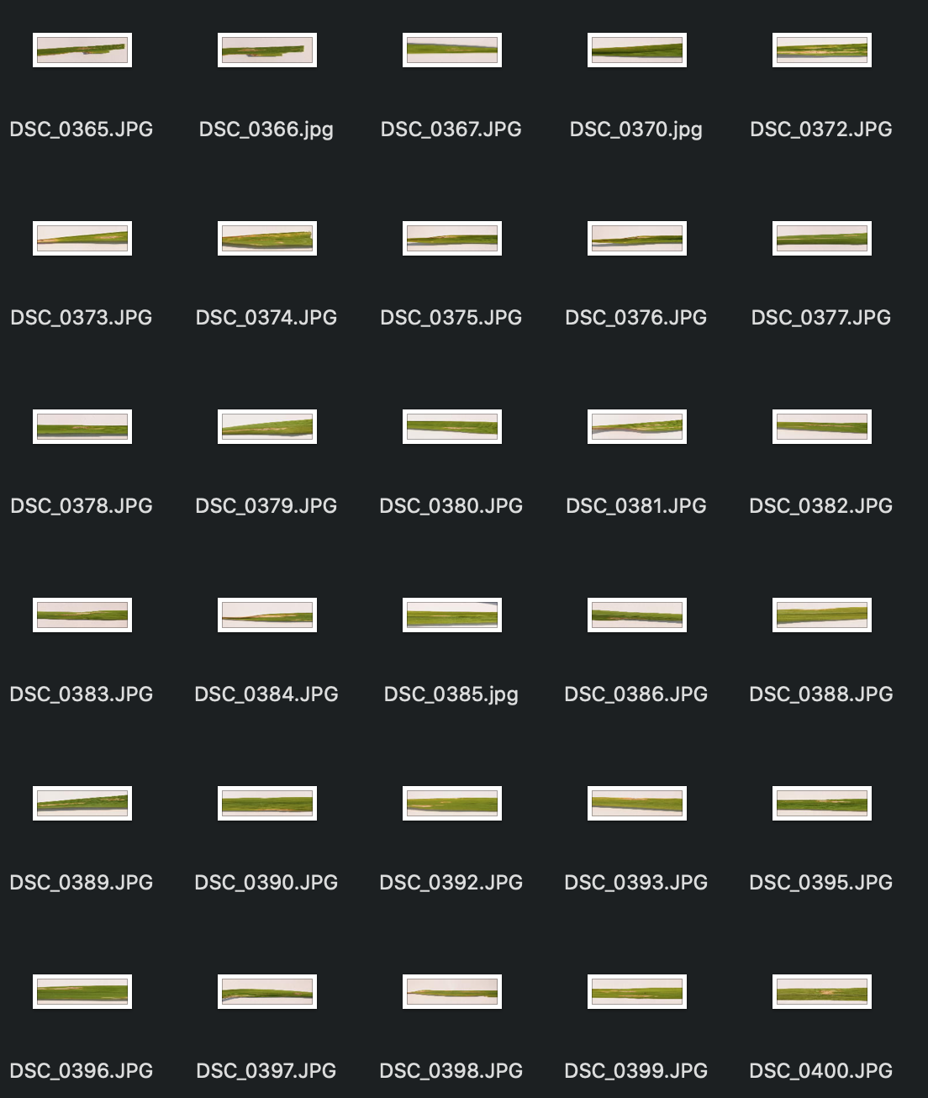
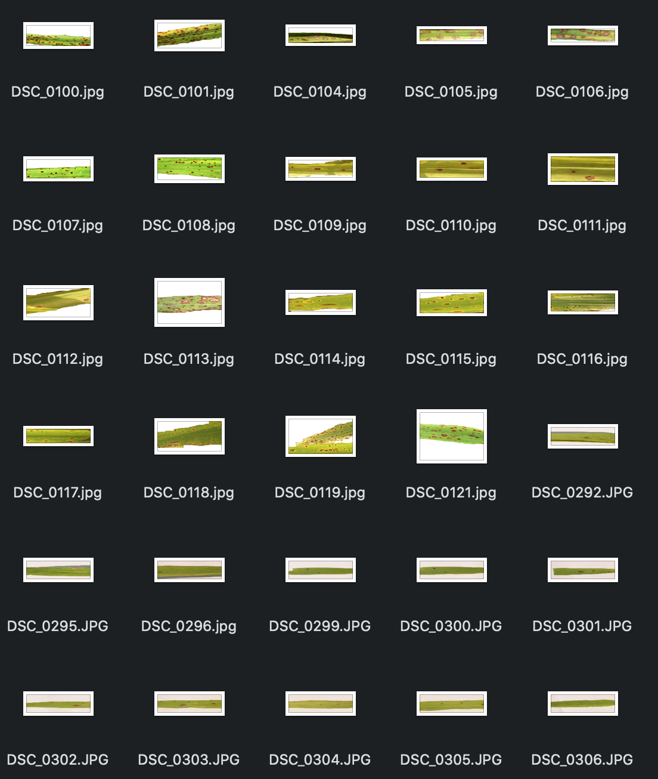
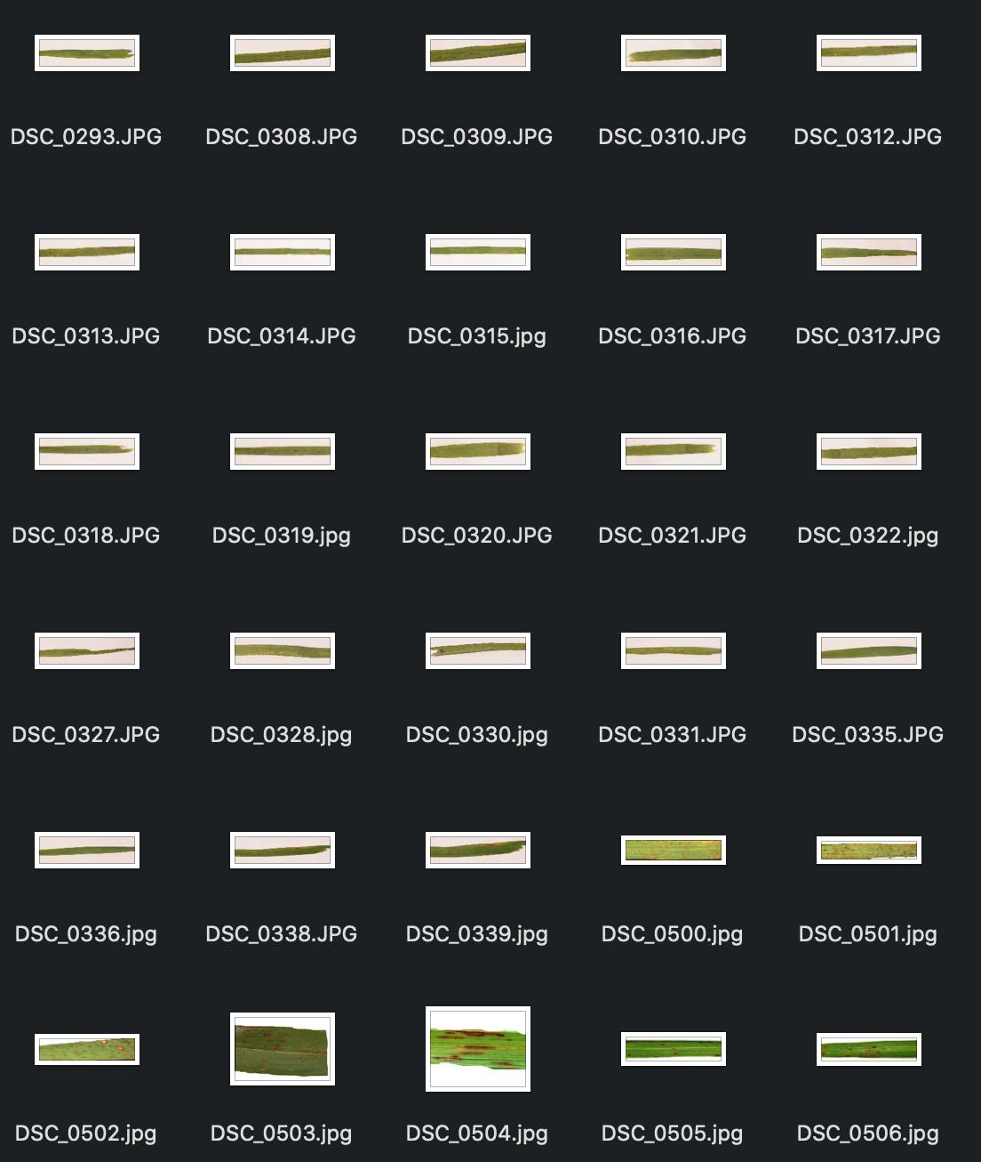
Dataset
The dataset contains images of rice leaf.
There are three classes/diseases: Bacterial leaf blight, Brown spot, and Leaf smut, each having 40 images.
The format of all images are jpg.
The number of data in dataset were less so to increase the number of images we have use data augmentation.

Slide 12
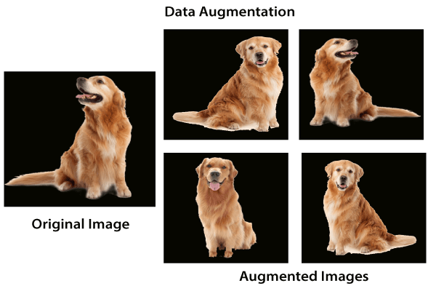
Data Augmentation
Image data augmentation is a technique that can be used to artificially expand the size of a training dataset by creating modified versions of images in the dataset.
Training deep learning neural network models on more data can result in more skillful models, and the augmentation techniques can create variations of the images that can improve the ability of the fit models to generalize what they have learned to new images.
The Keras deep learning neural network library provides the capability to fit models using image data augmentation via the ImageDataGenerator class.

Slide 13
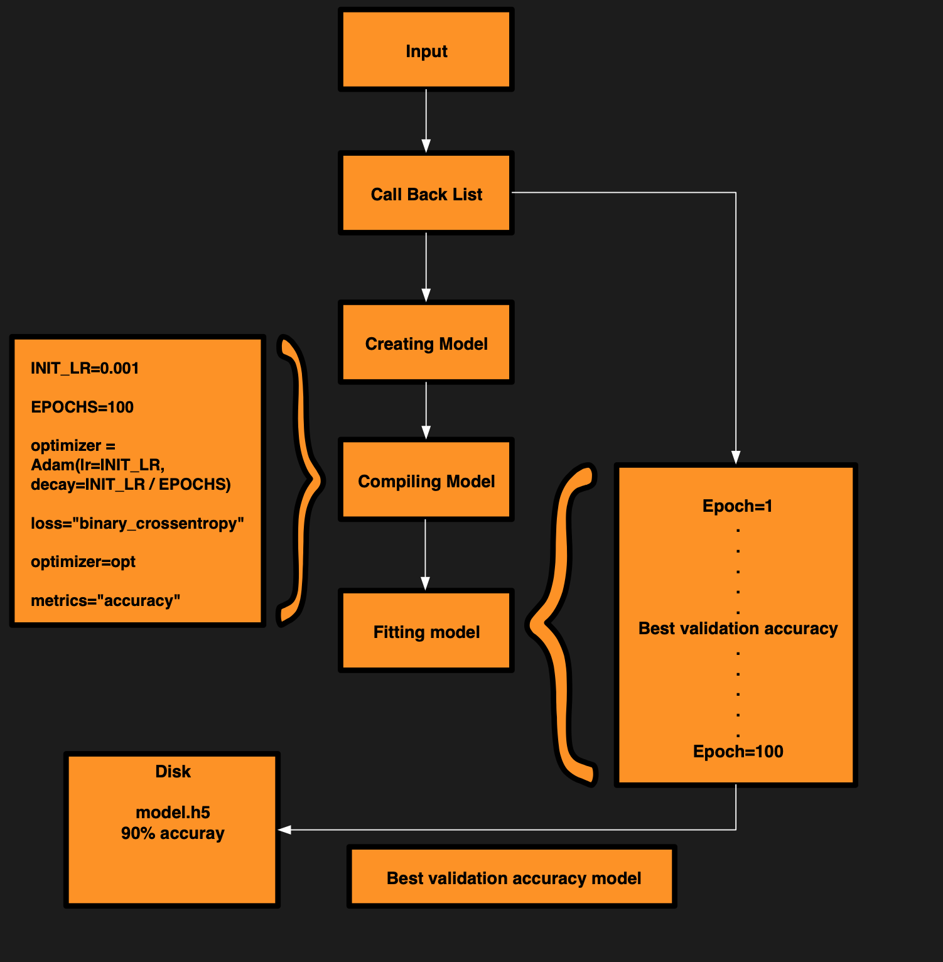
Checkpointing Neural Network Models
It is an approach where a snapshot of the state of the system is taken in case of system failure. If there is a problem, not all is lost. The checkpoint may be used directly, or used as the starting point for a new run, picking up where it left off.
In our model we have used checkpoint to save the model with the highest validation accuracy.
The flow chart will help you in understanding the functionality of it.

Slide 14
CNN Architecture
The model’s architecture consists of two main parts, five convolutional blocks and two fully connected neural network layer.
The inputs to this model are 220x220 images.
We are using five convolutional layers with one using 32 (3x3) filter, two using 64 (3x3) filter and the other two using 128 (3x3) filter and ReLU as an activation function followed by max pooling layer of pool and dropout.
The output of convolutional layer is flattened and sent to first fully connected layer of 1024 neurons followed by ReLU activation, Batch Normalization and Dropout and then to 3 neuron layer with softmax activation function which will give us our output.

Slide 15
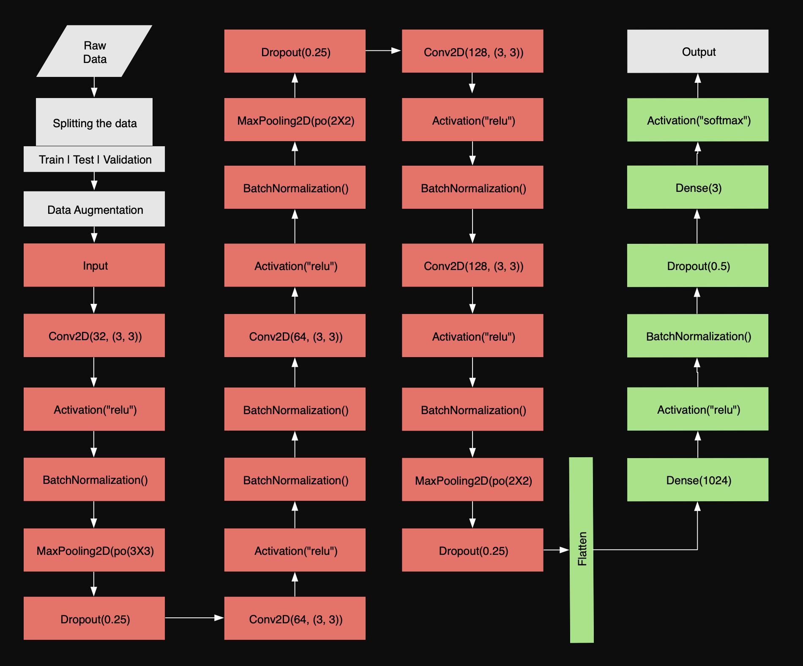
Our Model

Slide 16
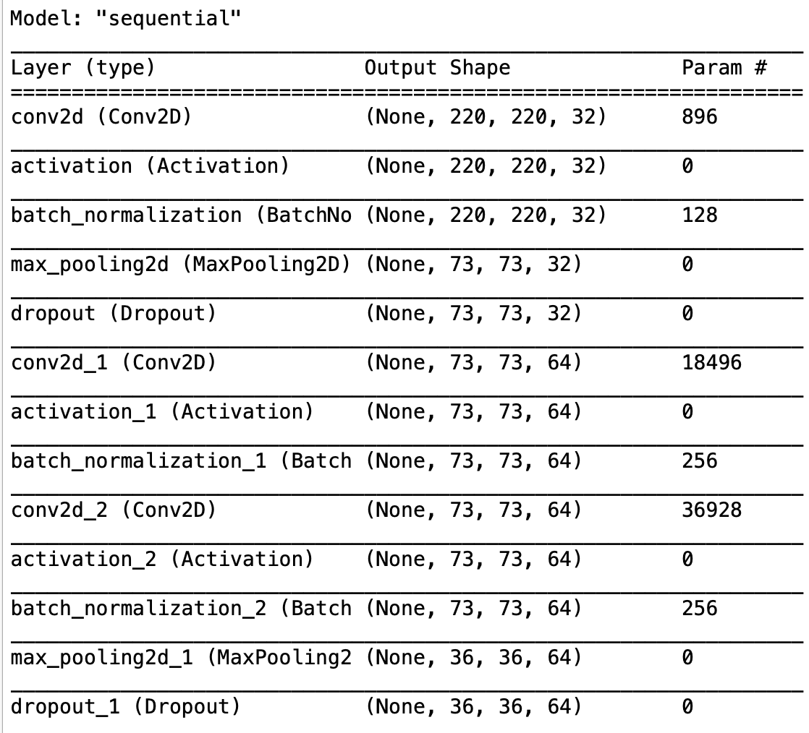
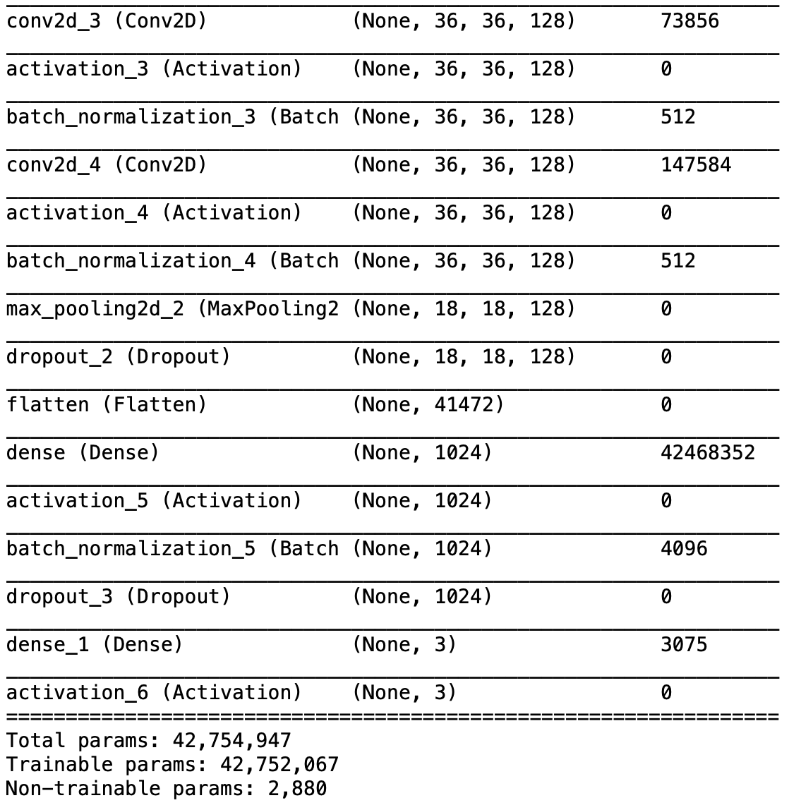
Summarizing the model

Slide 17
Thank You

